Slide 1
Neural Network Modeler Powered by: Watson Studio
Akshay Sethi

Slide 2

Outline
Neural Network Modeler(NNM)
Use of IBM Cloud Object Store (COS)
Design your deep learning model in NNM
Train your deep learning model
Download the trained model

Slide 3

Requirement
IBM Bluemix Cloud Account
http://console.bluemix.com/
IBM Watson Studio / Data Science Experience Account
http://datascience.ibm.com/
Tutorial Dataset and Wiki
https://github.ibm.com/DARVIZ/darviz/wiki/NNM-Tutorial

Slide 4

Hands-on Session

Slide 5

Steps
Create cloud object store service at IBM cloud dashboard
Upload data to COS
Create deep learning project in Watson studio
Create new modeler flow
Design valid network in canvas
Publish the network for training
Create experiment to train the model
Training definition
View and monitor the logs
Download the trained model from result bucket of COS

Slide 6
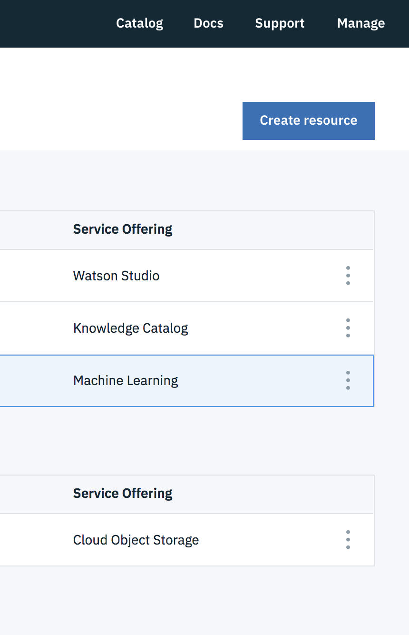
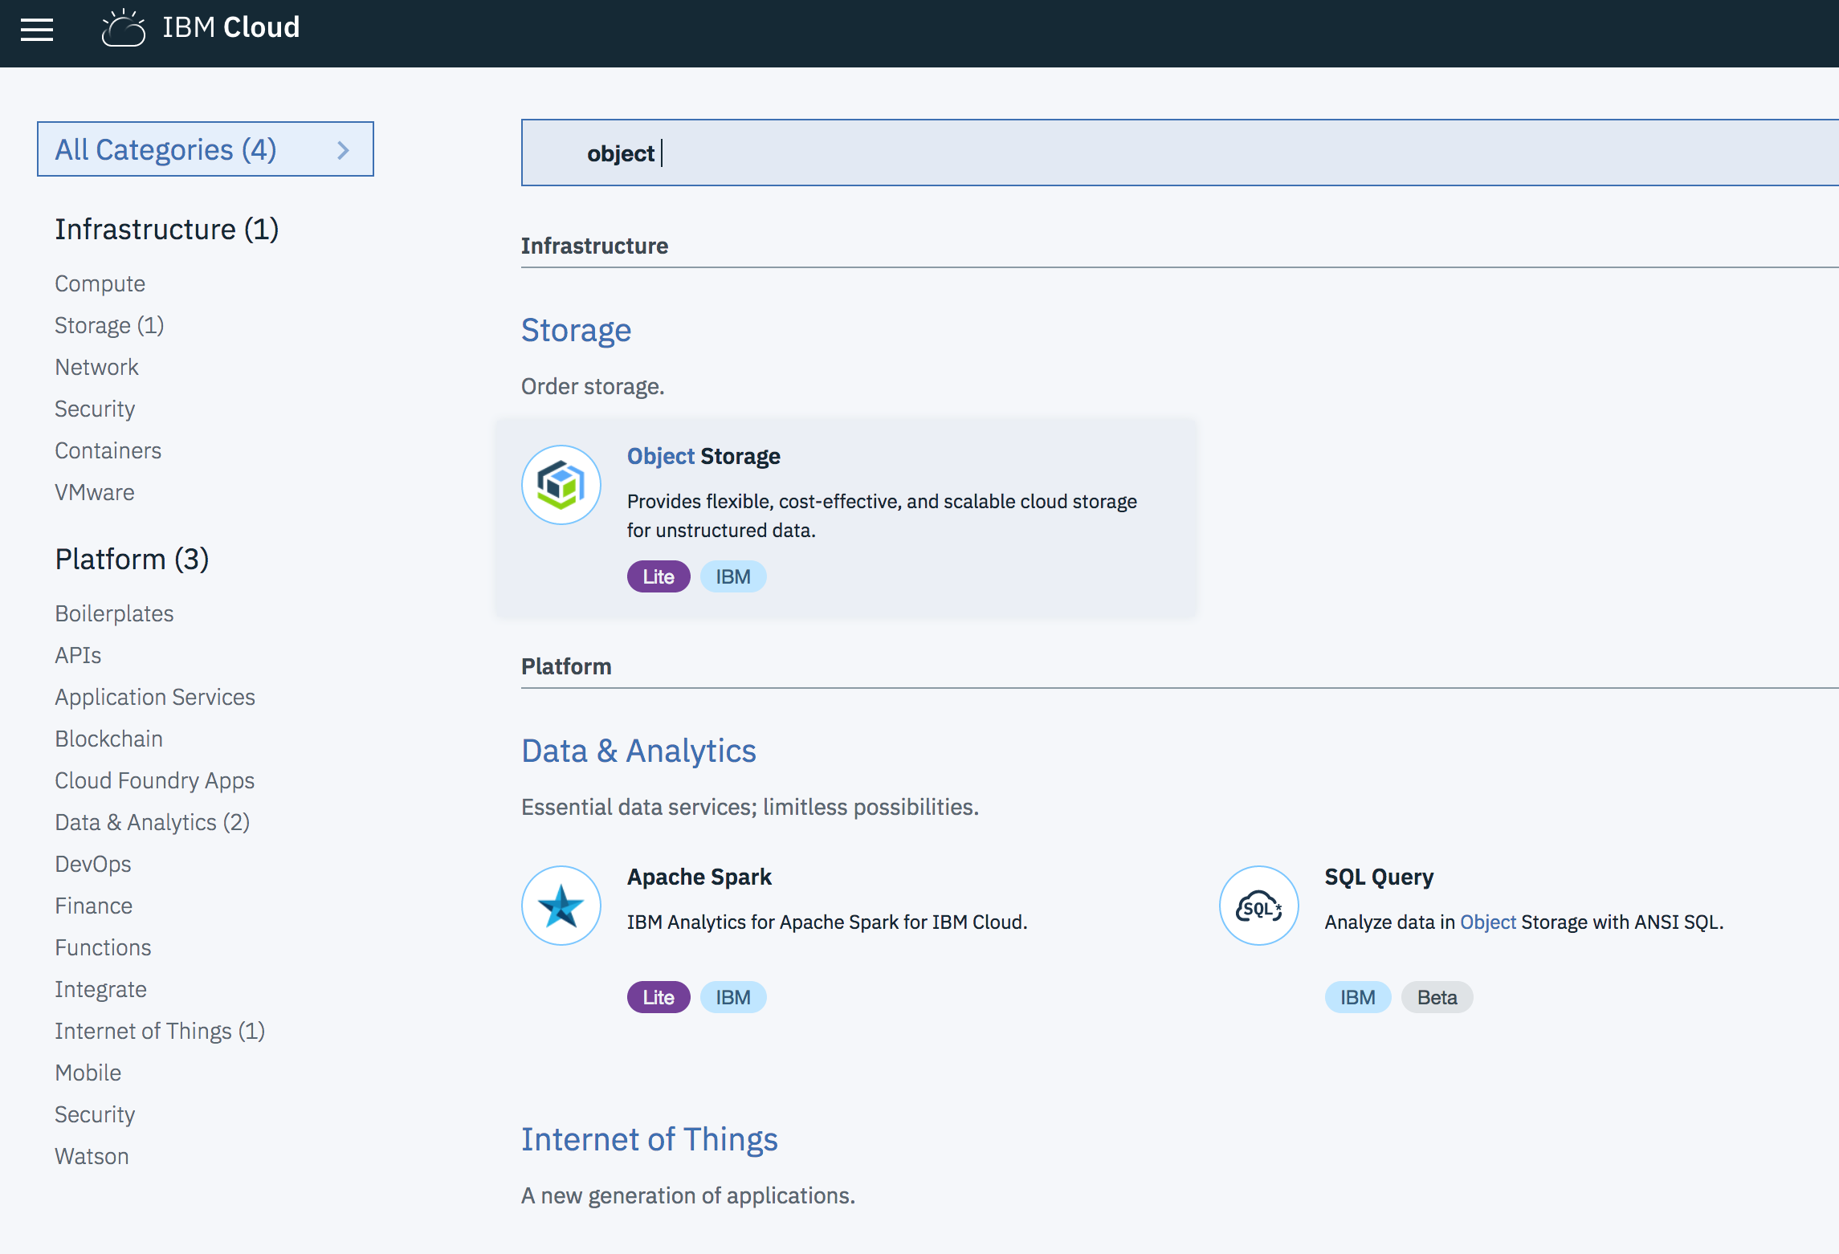

Cloud Object Storage
08/10/18

Slide 7
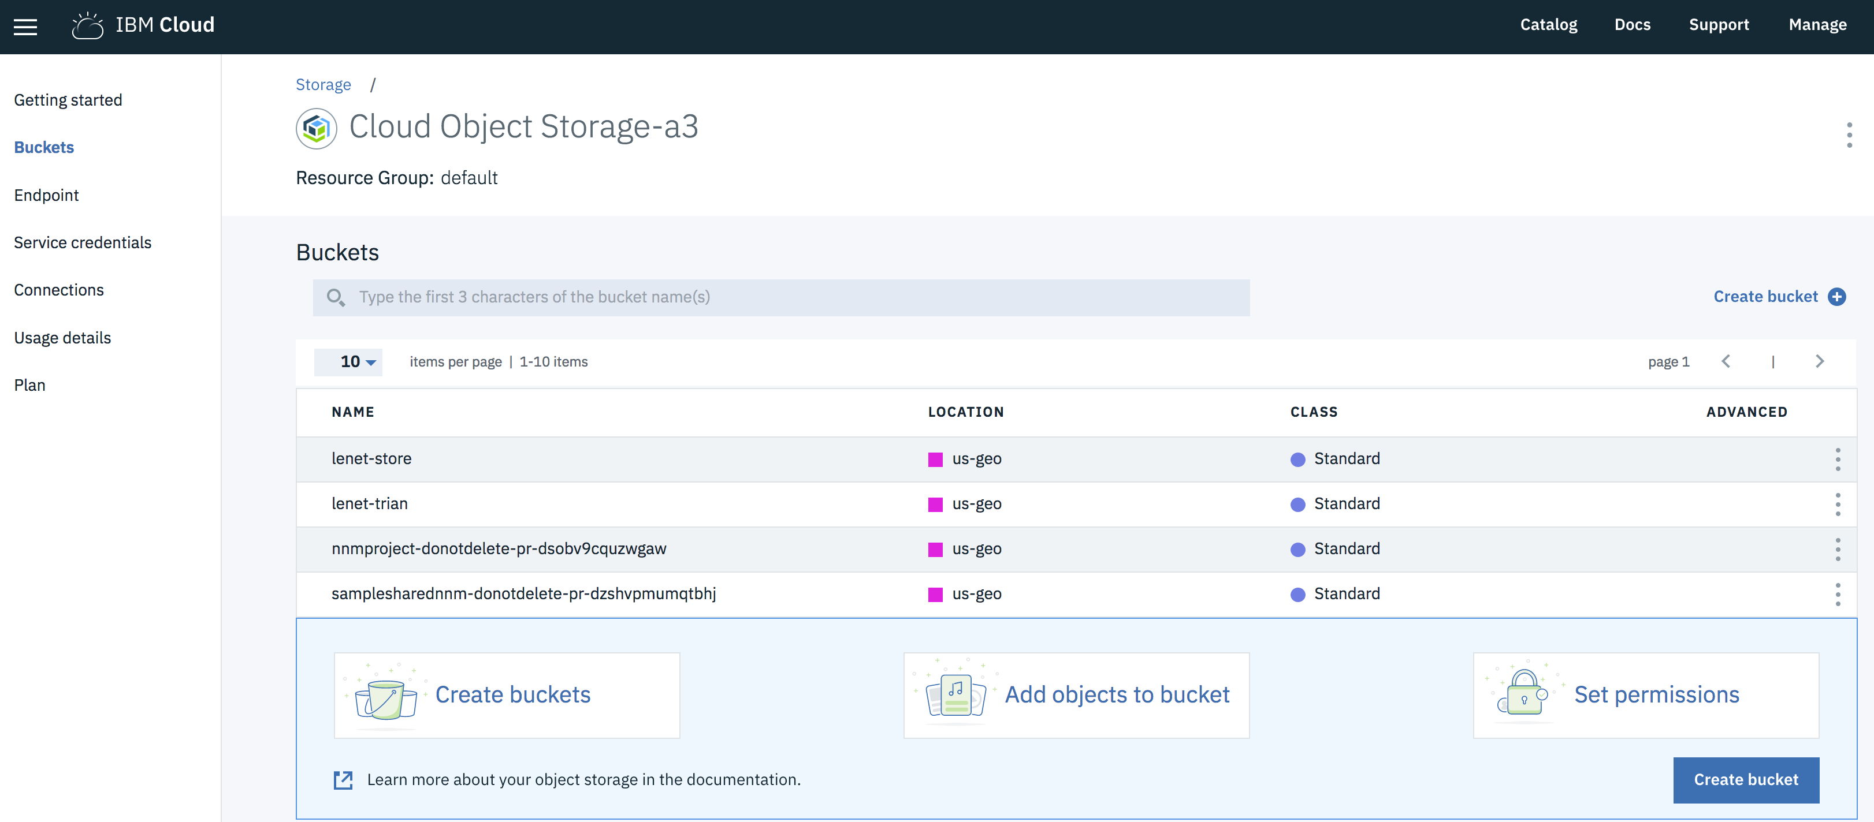
Upload Data to Bucket
08/10/18

Slide 8
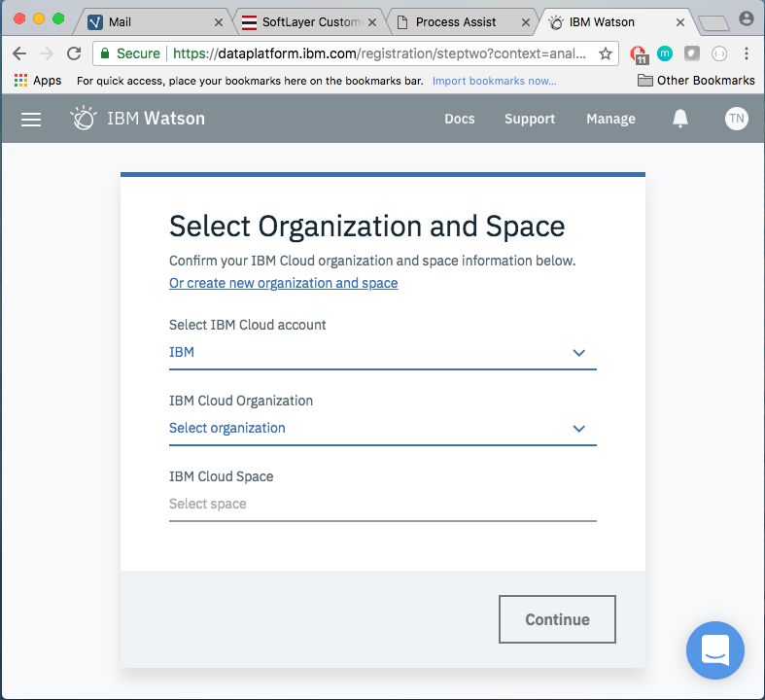
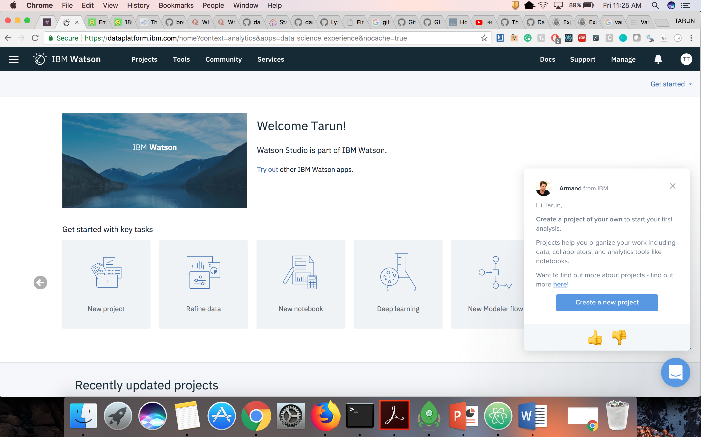
Watson Studio
08/10/18

Slide 9
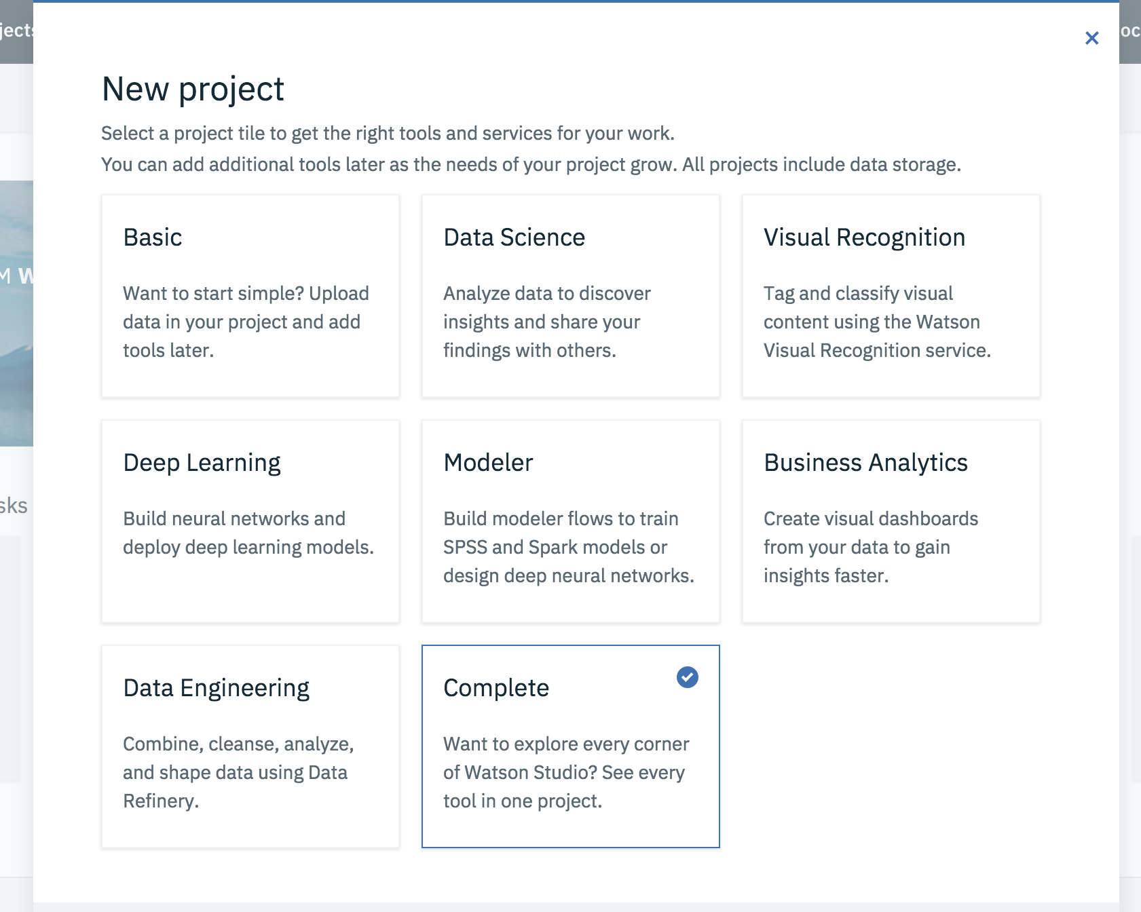
Deep Learning Project
08/10/18

Slide 10
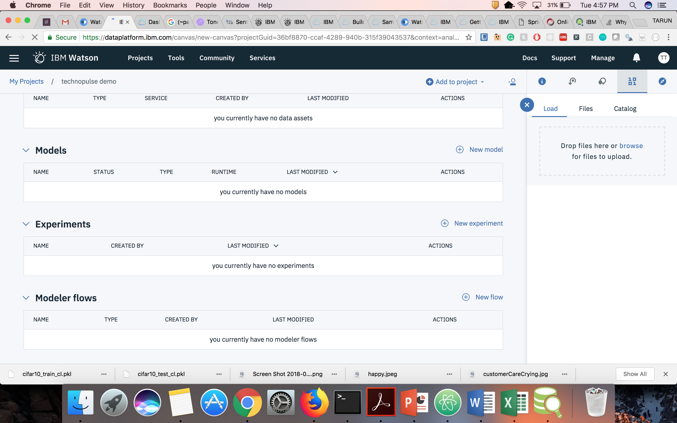
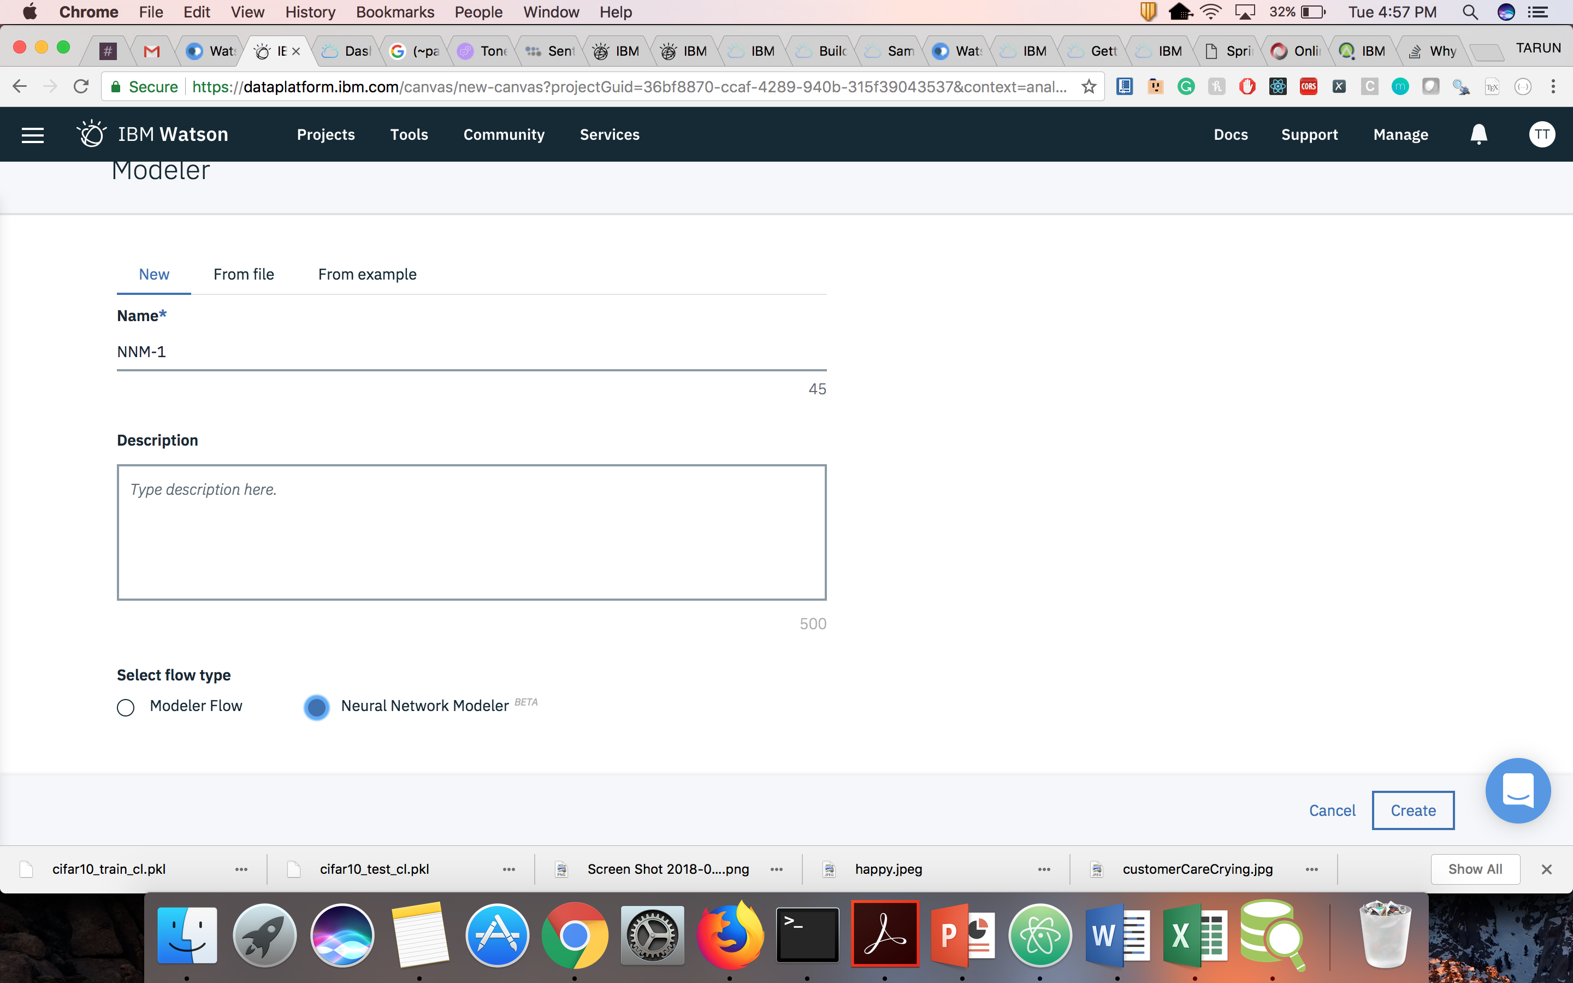
Modeler Flow
08/10/18

Slide 11
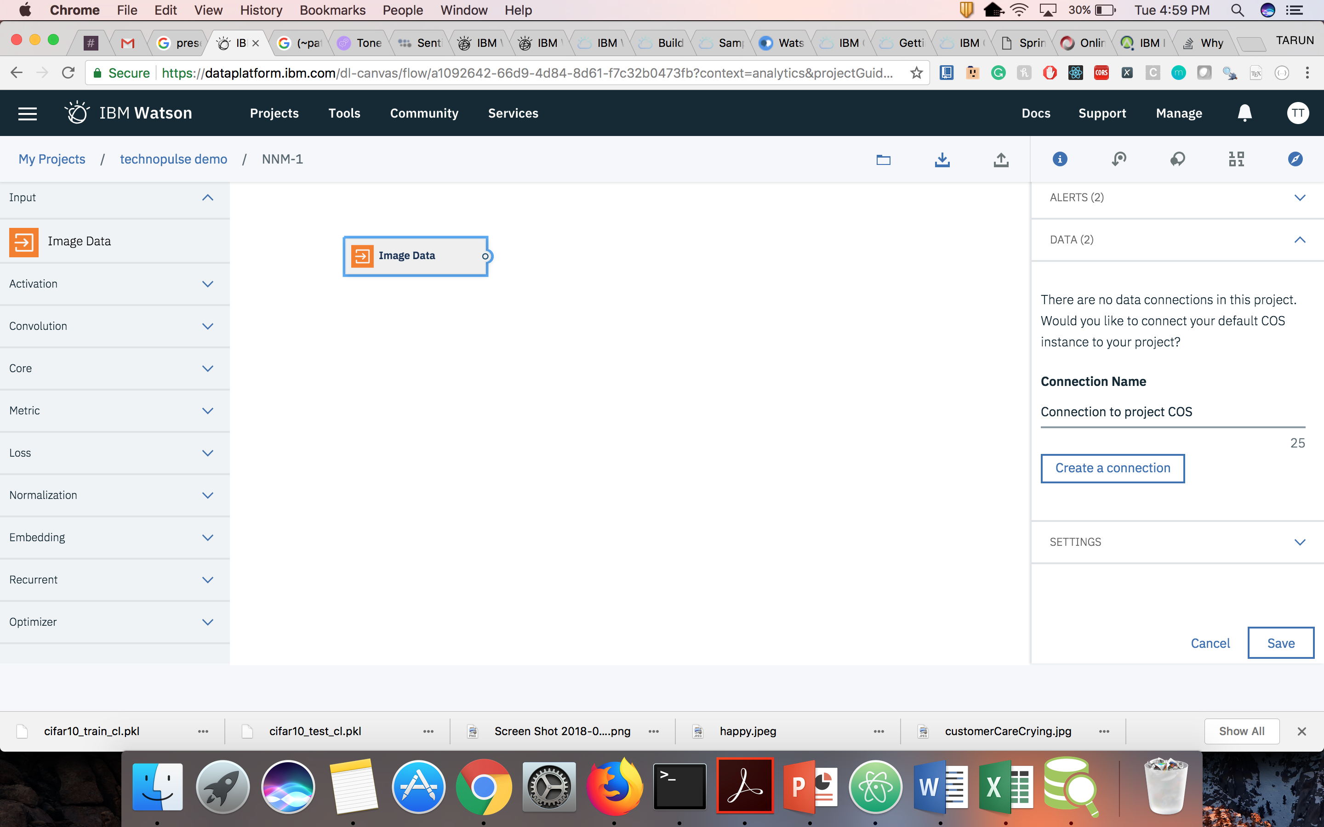
NNM Canvas
08/10/18

Slide 12
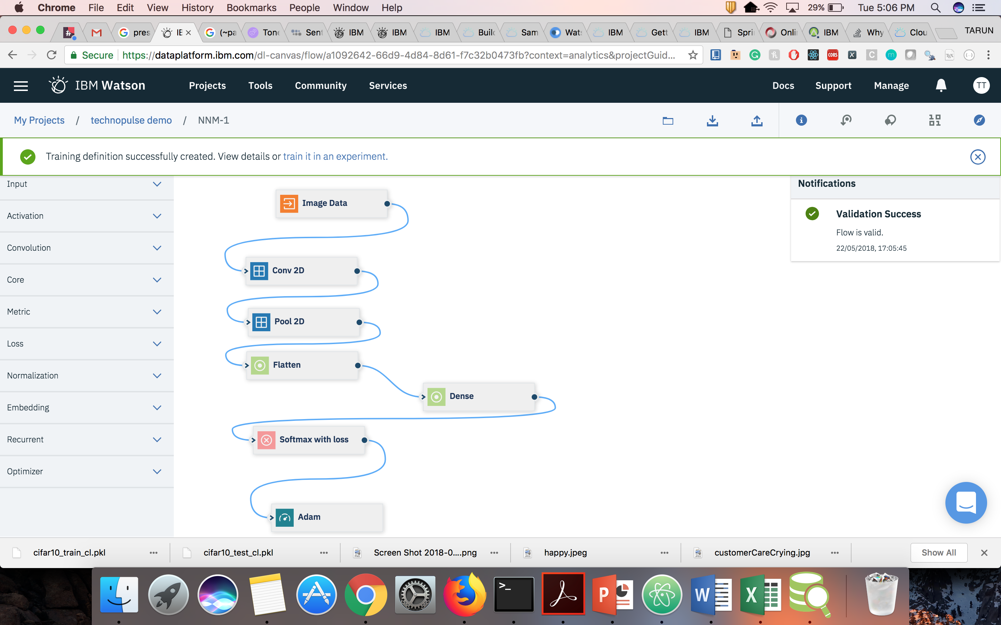
Publish Training
08/10/18

Slide 13
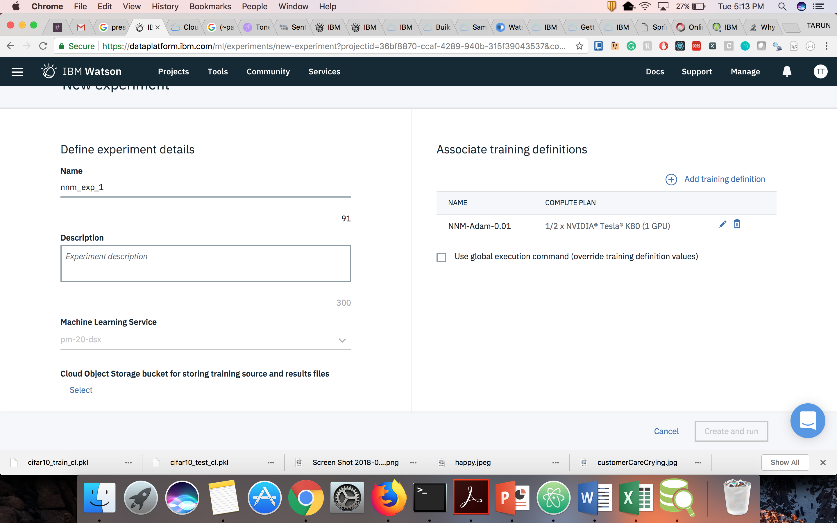
Create Experiment
08/10/18

Slide 14
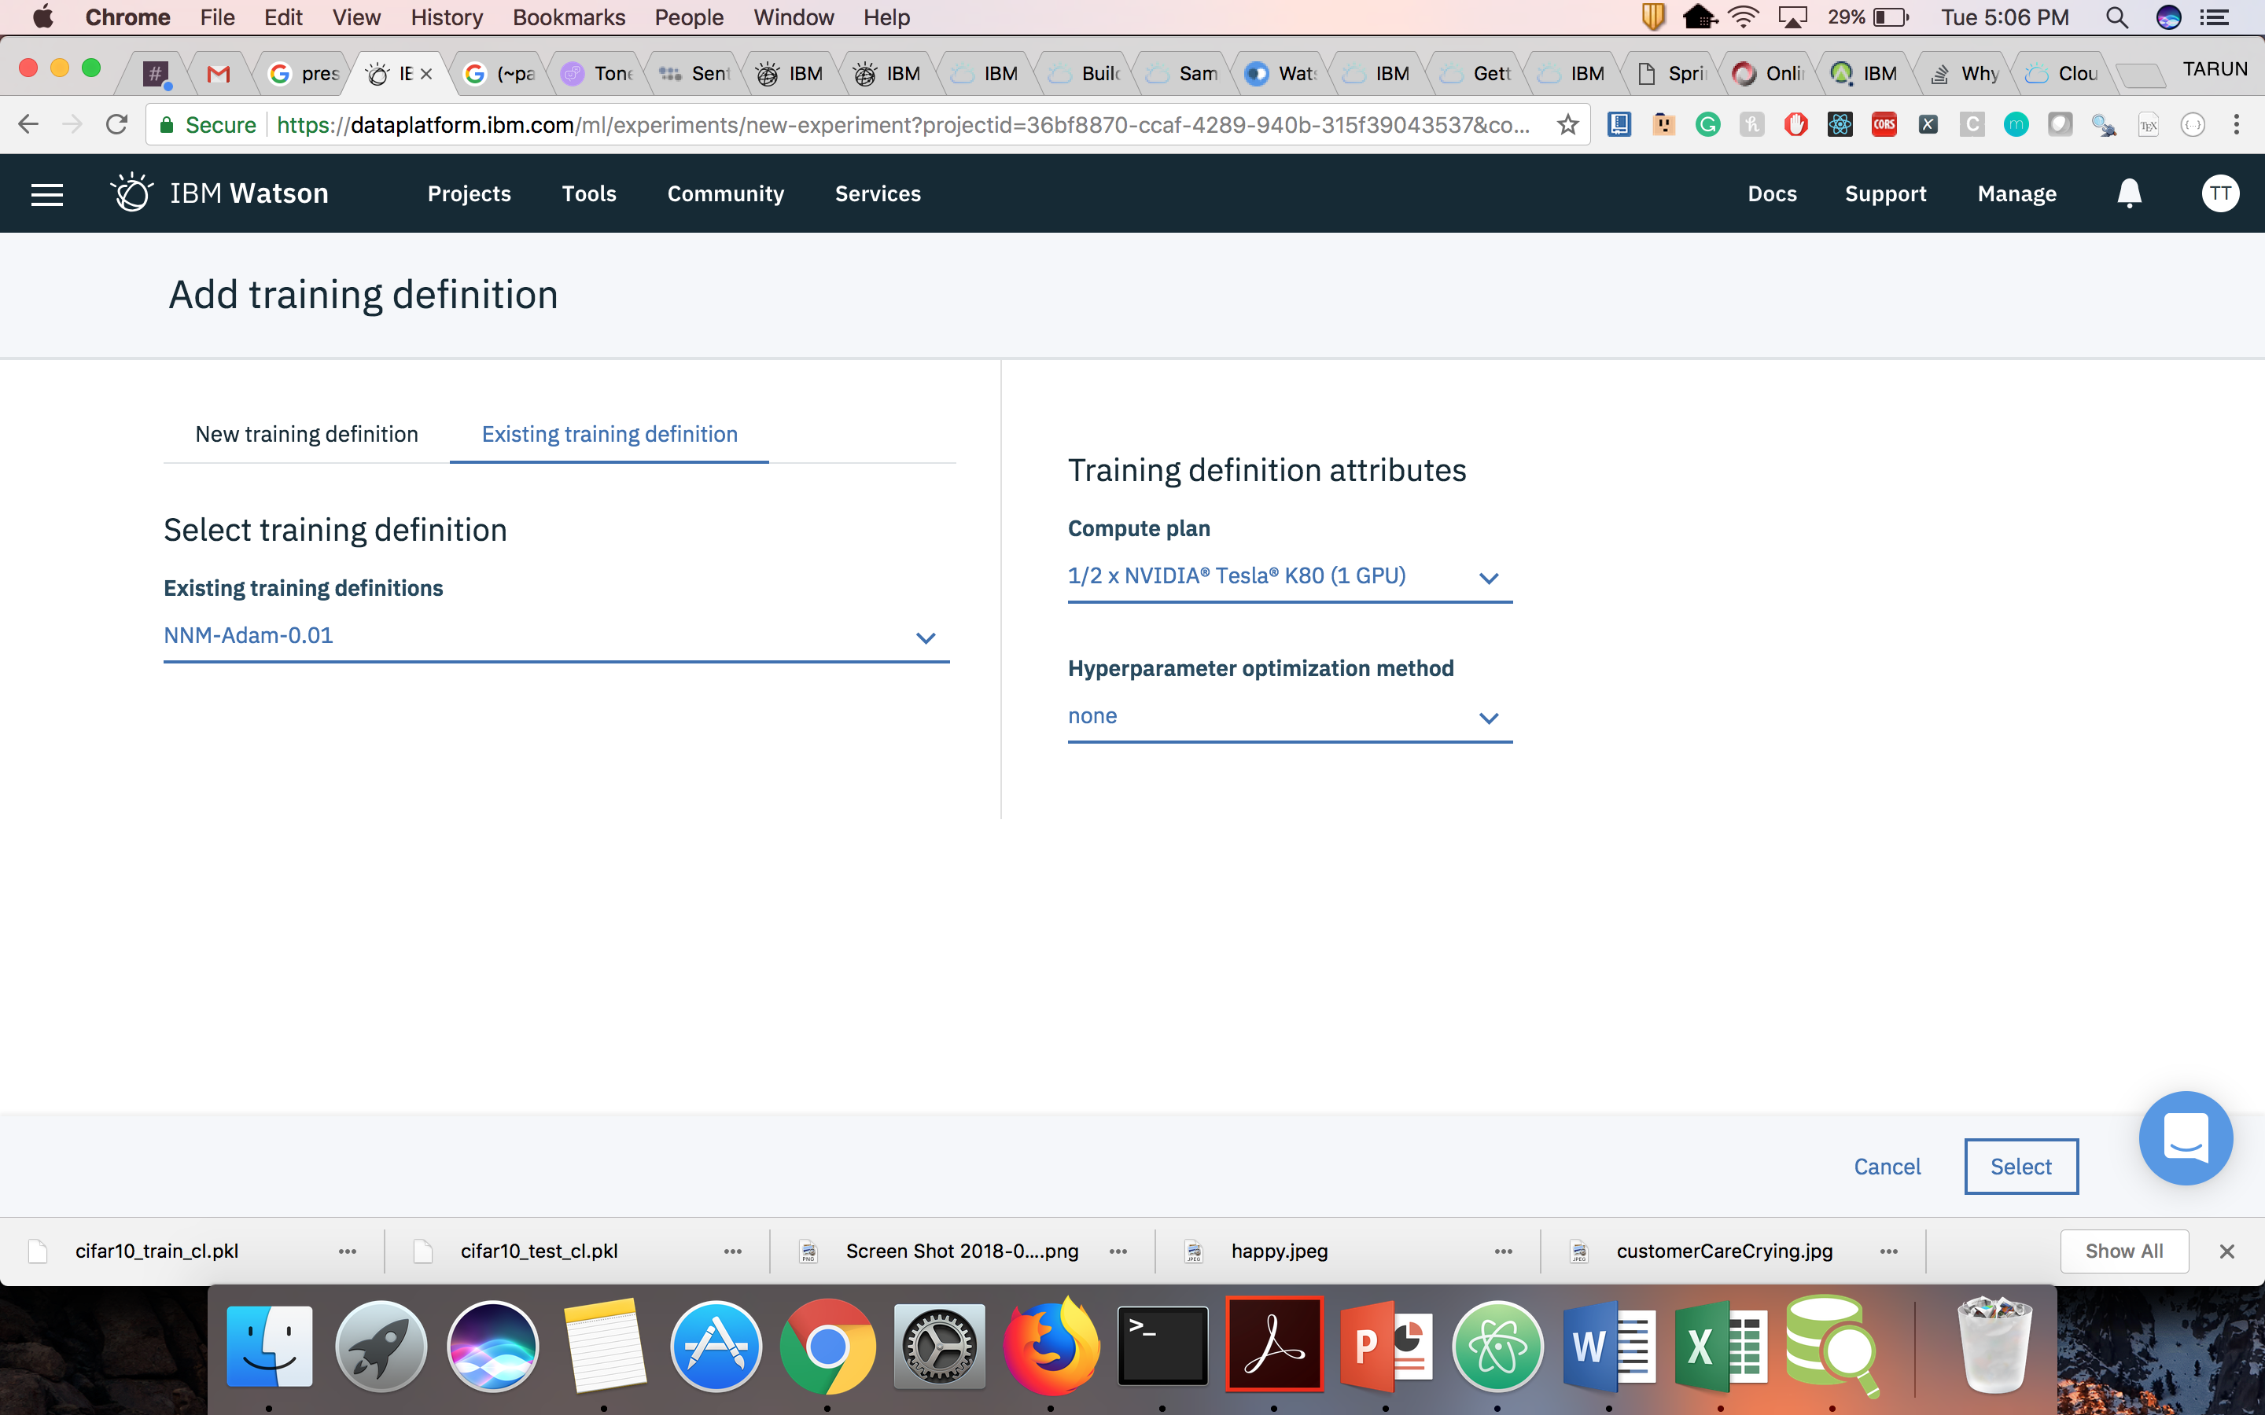
Add Training Definition
08/10/18
14

Slide 15
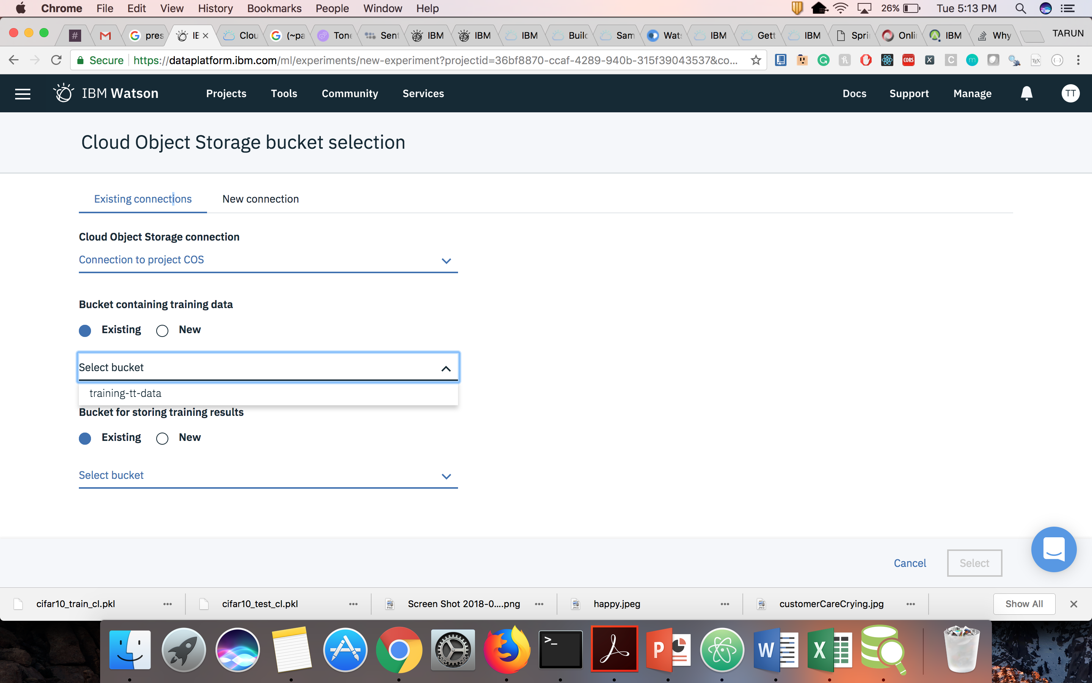
Add COS Details to Experiment
08/10/18
15

Slide 16
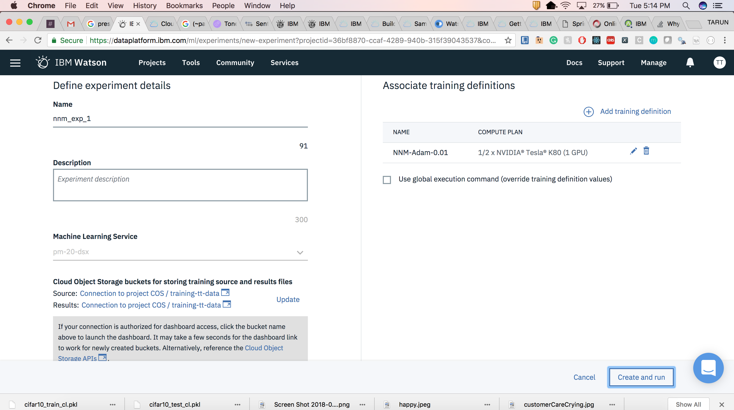
Create and Run
08/10/18
16

Slide 17
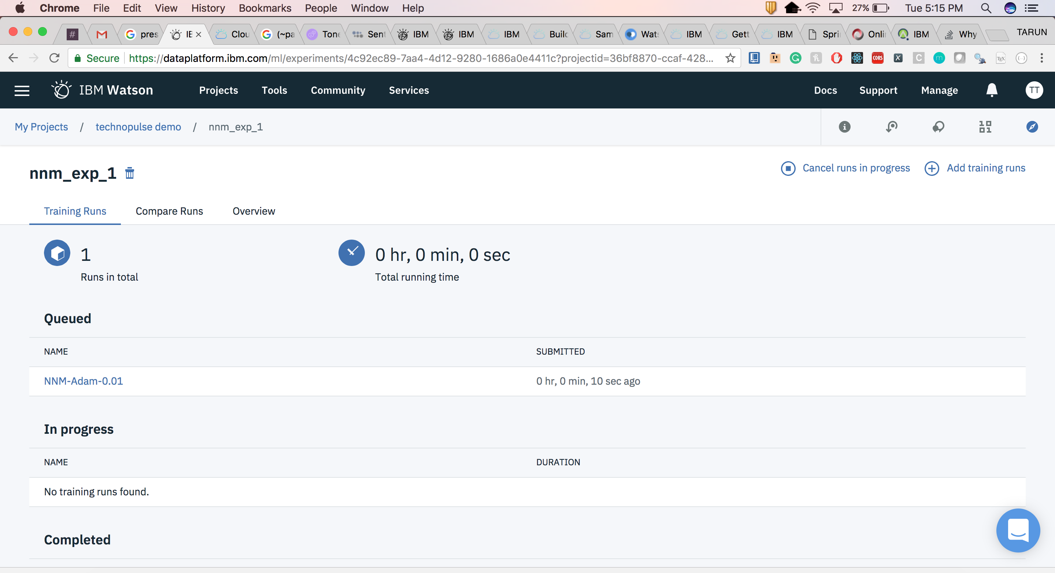
Experiments
08/10/18
17

Slide 18
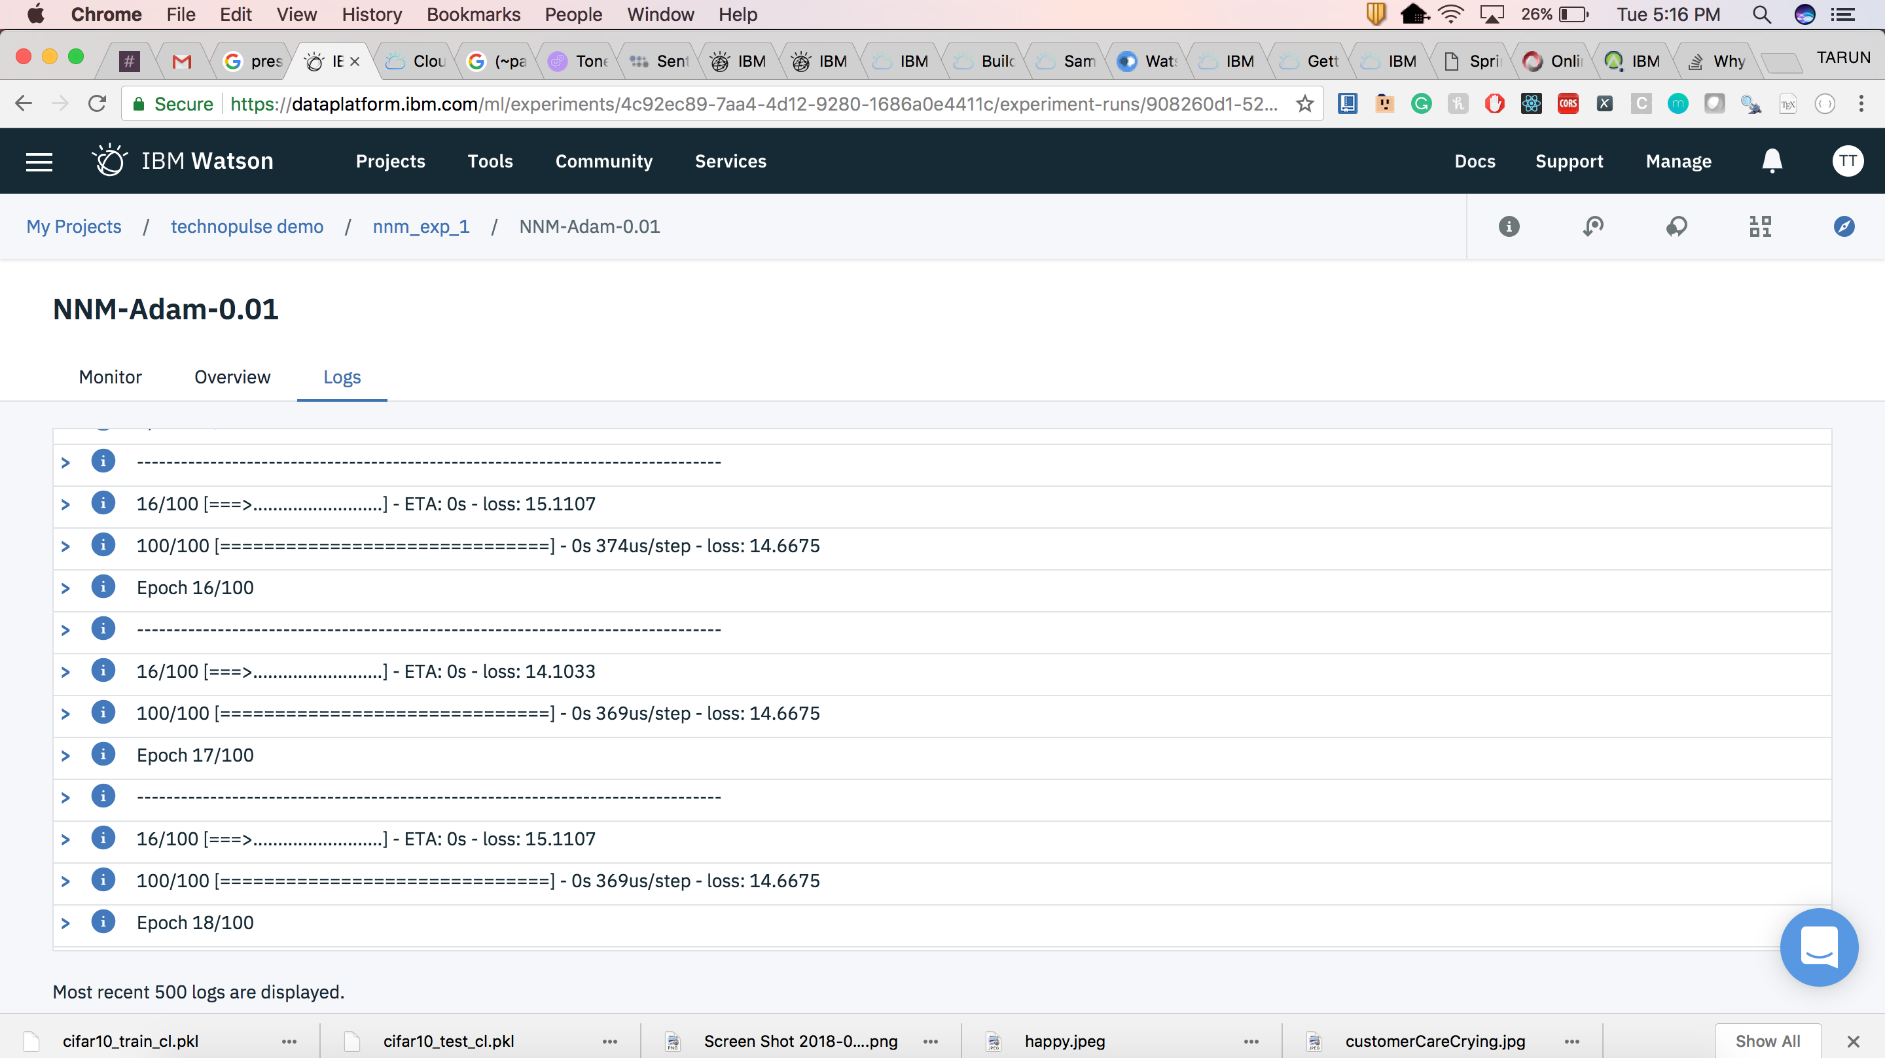
Logs
08/10/18
18

Slide 19
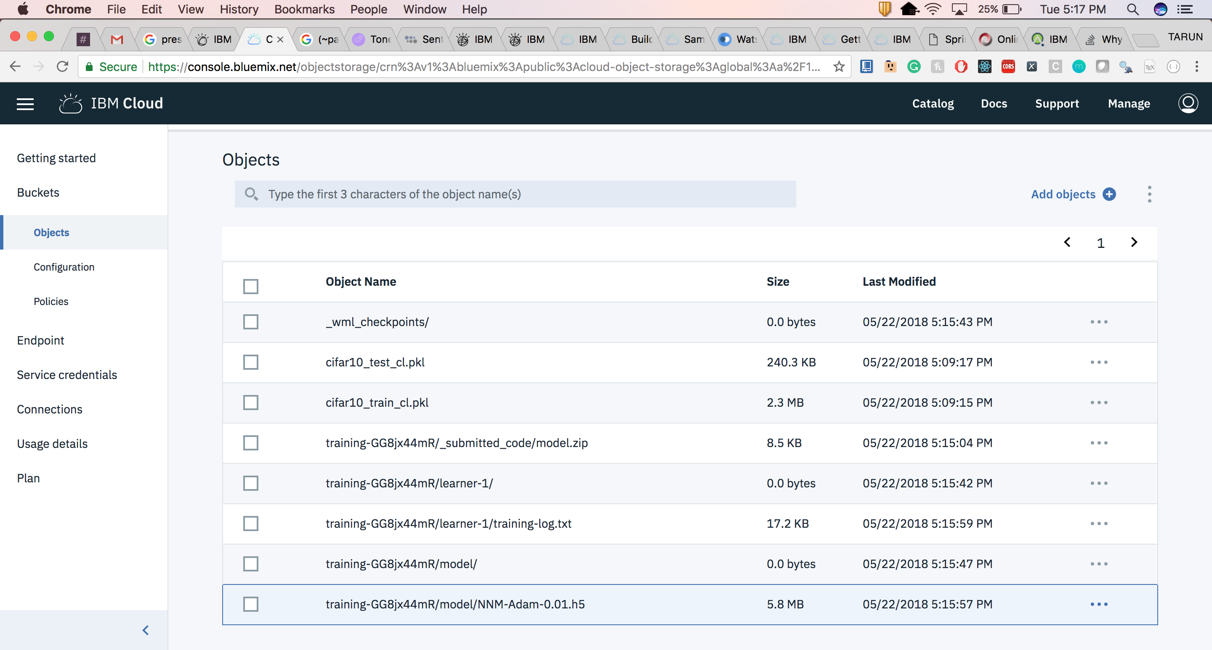
Trained Model
08/10/18
19

Slide 20
Public Tutorials
Exploring Deep Learning and Neural Network Modeler with Watson Studio https://medium.com/ibm-watson/exploring-deep-learning-and-neural-network-modeler-with-watson-studio-ead35d21a438
Accelerate Your Deep Learning Experiments with IBM’s Neural Network Modeler https://medium.com/ibm-watson/accelerate-your-deep-learning-experiments-with-ibms-neural-network-modeler-dd0c92fba814
Deep Learning as a Service Now in IBM Watson Studio https://medium.com/ibm-watson/deep-learning-now-in-ibm-watson-studio-d8ba311e4ff1
Video Tutorial https://www.youtube.com/watch?v=EDQ0AWcUBnE
08/10/18

Slide 21

Questions ?
Slack Channel: #wml_dl_user
08/10/18

Slide 22
Thank you ☺
08/10/18

